Slide 1
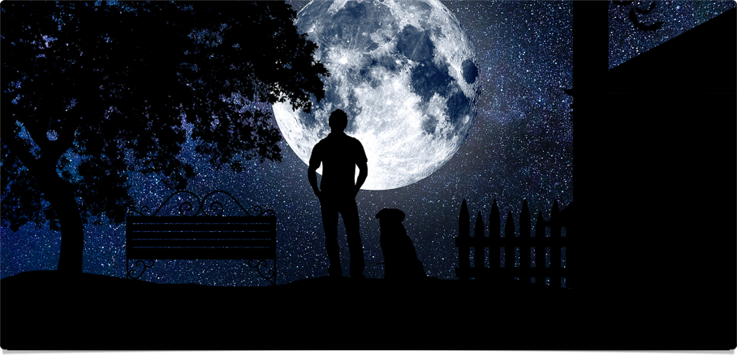
The Big Picture
Three Big Questions

Slide 2
“The Christian way of seeing things makes cognitive and existential sense of reality, offering us a powerful, persuasive, and attractive account of ourselves and our universe. Christianity does not simply make sense to us; it also makes sense of us. It positions us in the great narrative of cosmic history and locates us on a mental map of meaning. It offers us another way of seeing things, offers us another way of living, and invites us to share these.”
~ Alister McGrath, Surprised by Meaning, Conclusion

Slide 3


Psalm 19
Look Up (vv. 1ff; Rom 1:18-20; Psa 148)
Look Down (vv. 7ff; Rom 1:16-17; Psa 1)
Look Within (vv. 12ff; Rom 2:14-16; Psa 8)

Slide 4
Three Big questions
How is God revealing himself?
How does this make sense of us?
Where do you stand in this story?

Slide 5
The Big Picture
Three Big Questions

