Slide 1
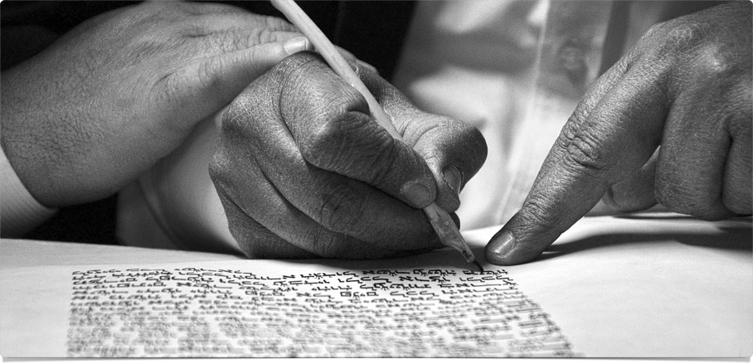
The Big Picture
A Story Worth Sharing

Slide 2
“The Christian way of seeing things makes cognitive and existential sense of reality, offering us a powerful, persuasive, and attractive account of ourselves and our universe. Christianity does not simply make sense to us; it also makes sense of us. It positions us in the great narrative of cosmic history and locates us on a mental map of meaning. It offers us another way of seeing things, offers us another way of living, and invites us to share these.”
~ Alister McGrath, Surprised by Meaning, Conclusion

Slide 3
Experience the Book
Watch & Discuss

Slide 4
“How the Bible has come down to us is a story of adventure and devotion. It is a story of toil and faith by those who, sometimes at great cost, passed down from generation to generation the message of salvation. The Bible did not just happen nor has it been preserved through the years by mere chance. Living in a day when books are written and printed by the thousands, we are apt to overlook the fascinating drama that lies behind our Bible.”
~ Neil Lightfoot, How We Got the Bible, ch. 1

Slide 5
Biblical Testimony
Prophetic Penmen (Exo 17:14; Jos 24:26; Jer 36:4)
Careful Copyists (Deu 4:2; 17:18ff; Pro 30:5f)
Public Presentations (Deu 31:9ff; Luke 4:16ff)
Apostolic Approval (1Pe 1:10ff; 2Pe 1:19ff)
Apostolic Authority (2Pe 3:15f; Col 4:16)

Slide 6
“Now to him who is able to strengthen you according to my gospel and the preaching of Jesus Christ, according to the revelation of the mystery that was kept secret for long ages but has now been disclosed and through the prophetic writings has been made known to all nations, according to the command of the eternal God, to bring about the obedience of faith—to the only wise God be glory forevermore through Jesus Christ! Amen.”
~ Romans 16:25-27 ESV

Slide 7
Making Manuscripts
Watch & Discuss

Slide 8
“The Hebrew Bible has come down to us through the scrupulous care of ancient scribes who copied the original text in successive generations. By the sixth century A.D. the scribes were succeeded by a group known as the Masoretes, who continued to preserve the sacred Scriptures … in a form known as the Masoretic Text. … Through subsequent editions, the ben Asher text became in the twelfth century the only recognized form of the Hebrew Scriptures.”
~ Preface to the New King James Version

Slide 9
“The currently renewed respect … for the Masoretic text is reflected in the ESV’s attempt, wherever possible, to translate difficult Hebrew passages as they stand…. In exceptional, difficult cases, the Dead Sea Scrolls, the Septuagint, the Samaritan Pentateuch, the Syriac Peshitta, the Latin Vulgate, and other sources were consulted to shed possible light on the text, or … to support a divergence.”
~ Preface to the English Standard Version

Slide 10
Why Trust the Bible?
Works (Dates) | Earliest Manuscripts | Number Surviving
Herodotus (484-425 BC) | 1st century AD (within 500 years) | 75
Thucydides (460-425 BC) | 1st century AD (500) | 20
Livy (59 BC – AD 17) | 4th century AD (400) | 27
Tacitus (AD 56-140) | 9th century AD (800) | 3
Suetonius (AD 69-140) | 9th century AD (800) | 200+
Old Testament (1446-445 BC) | 250 BC – AD 135 (600+) | 12,500
New Testament (AD 40-100) | AD 100-150 (50) | 20-25,000
Adapted from The ESV Study Bible

Slide 11
“Scribes introduced variants for all kinds of reasons. Sometimes it was purely accidental. For example, 1etters that looked similar miqht be switcheb out for each other; one word might be substituted for another won that sounded the same when read; words might skipped; words or letters might be be doubled; even whole sections might be skipped when the same word was used a few lines apart.”
~ Greg Gilbert, Why Trust the Bible?, ch. 3

Slide 12
“Scribes introduced variants for all kinds of reasons. Sometimes it was purely accidental. For example, 1etters that looked similar miqht be switcheb out for each other; one word might be substituted for another won that sounded the same when read; words might — skipped; words or letters might be be doubled; even whole sections might be skipped when the same word was used a few lines apart.”
~ Greg Gilbert, Why Trust the Bible?, ch. 3

Slide 13
“There is more manuscript support for the New Testament than for any other body of ancient literature. … Some variations exist in the spelling of Greek words, in word order, and in similar details. These ordinarily do not show up in translation and do not affect the sense of the text in any way. Other manuscript differences … should not overshadow the overwhelming degree of agreement which exists among the ancient records.”
~ Preface to the New King James Version

Slide 14
“The ESV is an ‘essentially literal’ translation that seeks as far as possible to capture the precise wording of the original text and the personal style of each Bible writer. … Thus it seeks to be transparent to the original text, letting the reader see as directly as possible the structure and meaning of the original. … Within this framework we have sought to be ‘as literal as possible’ while maintaining clarity of expression and literary excellence.”
~ Preface to the English Standard Version

Slide 15
Three Big Questions
How is God revealing himself?
How does this make sense of us?
Where do you stand in this story?

Slide 16
The Big Picture
A Story Worth Sharing

