Slide 1
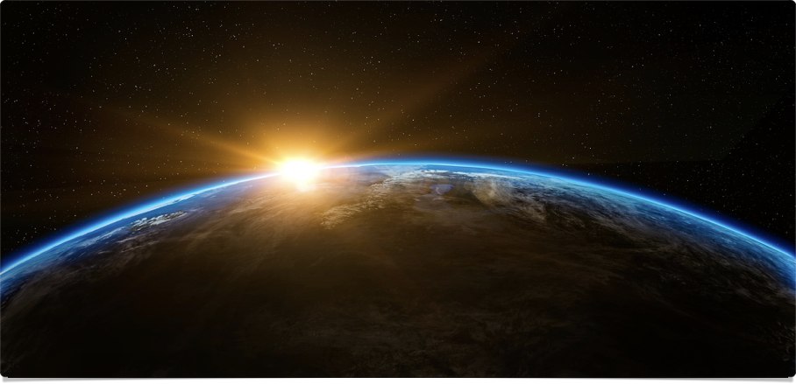
The Big Picture
In the Beginning

Slide 2
“The Christian way of seeing things makes cognitive and existential sense of reality, offering us a powerful, persuasive, and attractive account of ourselves and our universe. Christianity does not simply make sense to us; it also makes sense of us. It positions us in the great narrative of cosmic history and locates us on a mental map of meaning. It offers us another way of seeing things, offers us another way of living, and invites us to share these.”
~ Alister McGrath, Surprised by Meaning, Conclusion

Slide 3
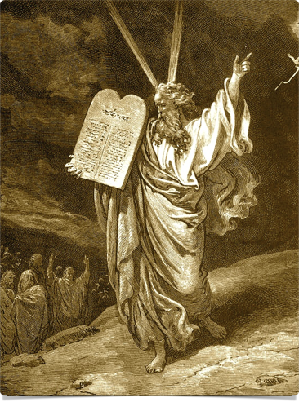

Four Readers
A: Gen 1:1-2
  B: Gen 1:3-5
    C: Gen 1:6-8
      D: Gen 1:9-13
  B: Gen 1:14-19
    C: Gen 1:20-23
      D: Gen 1:24-31
A: Gen 2:1-4

Slide 4
God’s Workweek
Preface (1:1-2)
Six workdays (1:3-31)
  “And God said”
  “It was [very] good” (v. 31)
  “And there was evening and there was morning, the nth day”
Seventh day (2:1-4)
  No “evening and ... morning” (Heb 4:4-11)

Slide 5

His Story… our story
“The earth was without form and void, and darkness was over the face of the deep. And the Spirit of God was hovering over the face of the waters” (Gen 1:2).
Forming opus divisionis | Filling opus ornatus
Day 1: light & dark | Day 4: lights of day & night
Day 2: sea & sky | Day 5: fish & birds
Day 3: land & vegetation | Day 6: land animals & man
Day 7: Fellowship (Exo 20:11; Isa 66:1-2)

Slide 6
“All of creation is designed not for humans but for God, and all things on earth are called to worship this one true God. … Creation is God’s space, so that the radical scientific theory called ‘materialism’ or ‘naturalism’—in which what we see, taste, feel, and can test is all there is—is challenged by our creation account with this message: Look and see! God created this space; and in worship and service of God, others, and the rest of creation, we enter into God’s purpose for all of creation.”
~ Scot McKnight, Adam and the Genome

Slide 7
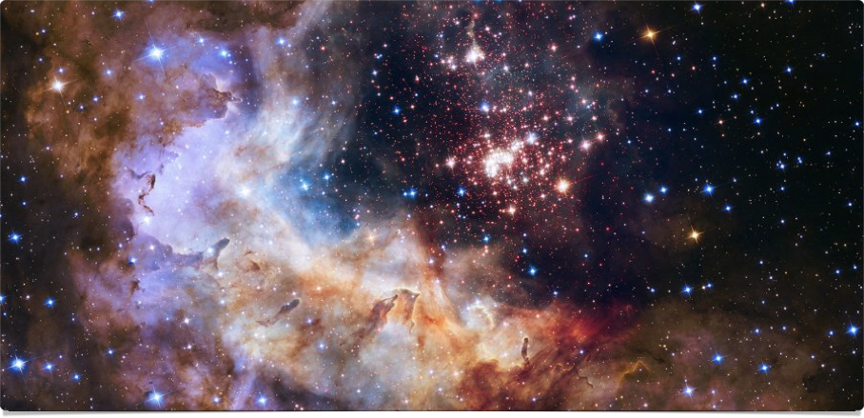
The Ingredients of Life
Watch & Discuss

Slide 8
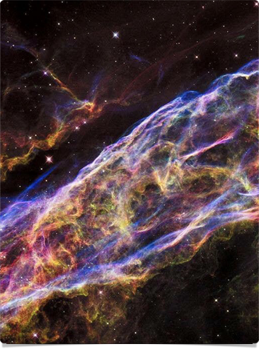
The Number N
Ratio of electromagnetic force to force of gravity
Holds atoms together to strength of gravity
Value: 10³⁶
Too high: all blue giants
Too low: all red dwarfs; no 2nd-gen stars, no carbon (C) or oxygen (O)

Slide 9
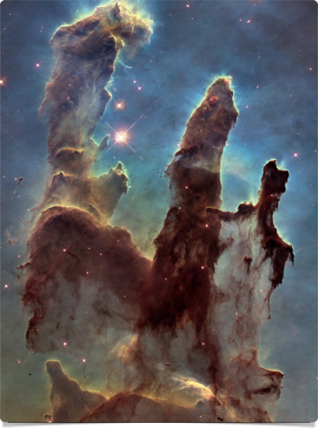
Epsilon (ε)
Strong nuclear force
Binds atomic nuclei & allows stars to transmute hydrogen (H) into other elements
Value: ~.007; not .006/.008
Too high: all H converts to helium; no H, no fusion, no C
Too low: universe is all H

Slide 10
Lambda (Λ)
Cosmic repulsion (expansion)
Value: 10⁻¹²⁰ (w/in 1 part in 10¹⁰⁰)
Einstein’s “greatest blunder”; “dark energy,” antigravity
Too high: stars & planets don’t form
Too low: universe collapses

Slide 11
The number Q
Ratio of gravitational binding force to rest-mass energy
Gravitational energy pulling galaxies apart & energy of their masses (e = mc²)
Value: 10⁻⁵
Too low: universe inert & structureless
Too high: dominated by black holes

Slide 12
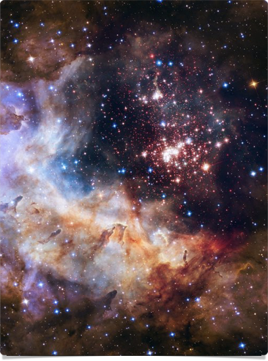
Omega (Ω)
Amount of matter in universe
Value: .3 to 1; originally ~1 +/- .000000000000001
One less quark/bil pairs of quarks & antiquarks, everything pure radiation
Like a hole-in-one from 13x distance from Earth to Pluto
Too high: universe collapses

Slide 13
The Fine-Tuning of the Universe
“ ... this experience of deriving simple and beautiful universal equations that describe the reality of the natural world left a profound impression on me, particularly because the ultimate outcome had such aesthetic appeal. This raises the first of several philosophical questions about the nature of the physical universe. Why should matter behave in such a way? In Eugene Wigner’s phrase, what could be the explanation for the ‘unreasonable effectiveness of mathematics’?”
~ Francis Collins, The Language of God, ch. 3

Slide 14
Four Possibilities
Fine-tuning is highly unlikely, but that’s the way it is.
We live in a “multiverse.” There are so many universes one of them was bound to support life.
The universe looks unlikely, but one day we’ll be able to explain it.
Fine-tuning points ultimately to the creativity of God.

Slide 15
“The odds against a universe like ours emerging out of something like the Big Bang are enormous. I think there are clearly religious implications.”
“It would be very difficult to explain why the universe should have begun in just this way, except as the act of a God who intended to create beings like us.”
~ Stephen Hawking; in Collins, The Language of God, ch. 3

Slide 16
Putting Things Together
Creation is radically dependent on a radically independent Creator (Col 1:15-20; Exo 3:14-15)
God creates & upholds a “covenant with day and night and a fixed order of heaven and earth” that makes science possible (Jer 33:25; Psa 19:1-6)
Be prepared to change your mind as more evidence comes to light (Heb 11:1; Jam 3:17-18)

Slide 17
“Now we see how the astronomical evidence leads to a biblical view of the origin of the world. The details differ, but the essential elements … are the same …. For the scientist who has lived by his faith in the power of reason, the story ends like a bad dream. He has scaled the mountains of ignorance; he is about to conquer the highest peak; as he pulls himself over the final rock, he is greeted by a band of theologians who have been sitting there for centuries.”
~ Robert Jastrow; in Collins, The Language of God, ch. 3

Slide 18
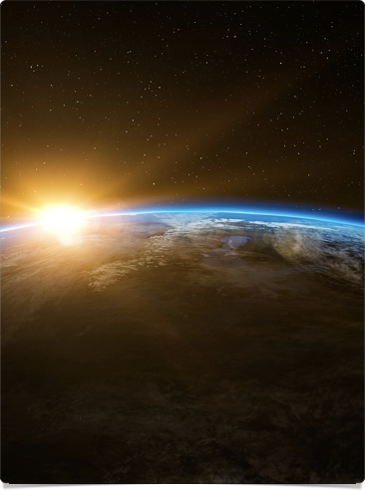
Three Big questions
How is God revealing himself?
How does this make sense of us?
Where do you stand in this story?

Slide 19
The Big Picture
In the Beginning

